Slide 1











9 Aug 2025
Capstone
Project
Sauce Demo
Presented by:
Rakshit Bhadoria (Java Selenium Batch – 3)
Notes:
https://www.freepik.com/free-ai-image/photorealistic-timber-house-interior-with-wooden-decor-furnishings_152371631.htm

Slide 2





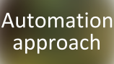














Table of
Contents
9 Aug 2025
Presented by:
Rakshit Bhadoria (Java Selenium Batch – 3)
Notes:
https://www.freepik.com/free-ai-image/photorealistic-timber-house-interior-with-wooden-decor-furnishings_152371631.htm

Slide 3

About
Project

Slide 4
About
Project
Goal: Build an end-to-end automation framework for Sauce Demo web app.
Automate critical functionalities using Selenium + TestNG.
Enable CI/CD pipeline with Jenkins for automatic test execution.
Use GitHub for version control & collaboration.
Track requirements, test cases, and bugs using Jira + Zephyr Board.

Slide 5

Tools Used

Slide 6
Tools Used
Core Automation & Framework
Collaboration & Project
CI/CD
Development Environment
Java, Selenium, TestNG, JUnit, Maven
Git/GitHub,
JIRA + Zephyr
Jenkins
Eclipse IDE

Slide 7

Automation
approach

Slide 8
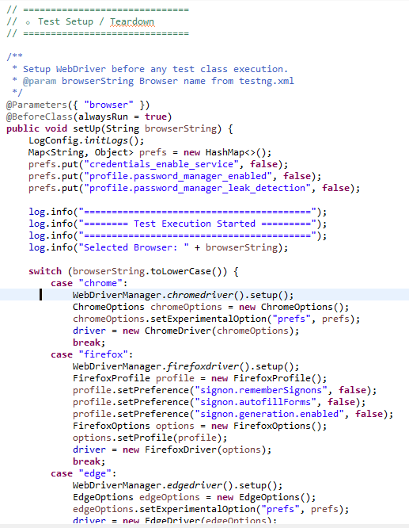
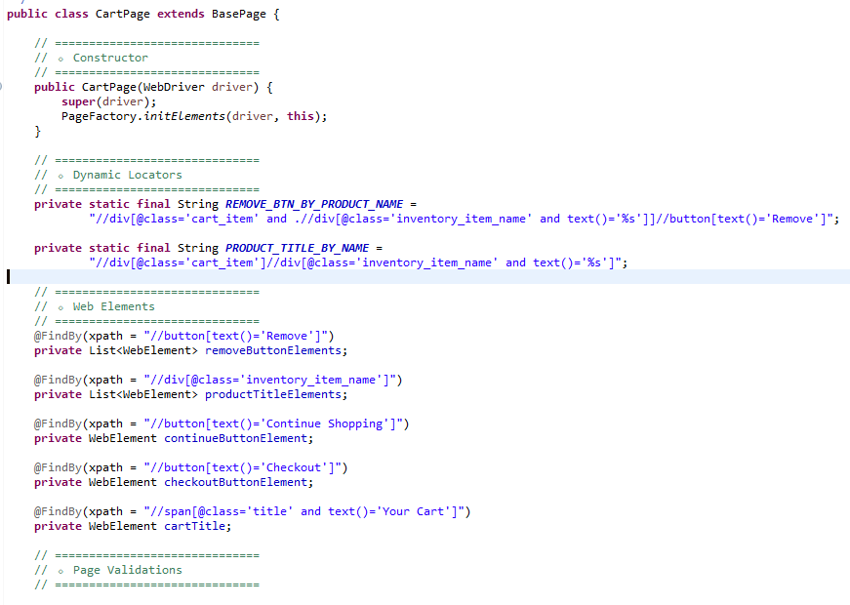
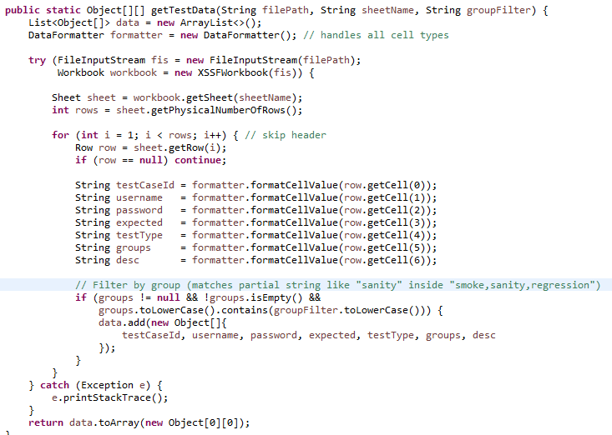
Automation
approach
Page Object Model
Data Driven Testing
Cross Browser Testing
separates page structure and test logic for maintainability
use excel to run tests with multiple inputs
validate application on Chrome, Firefox, etc.

Slide 9

Jira
Board

Slide 10
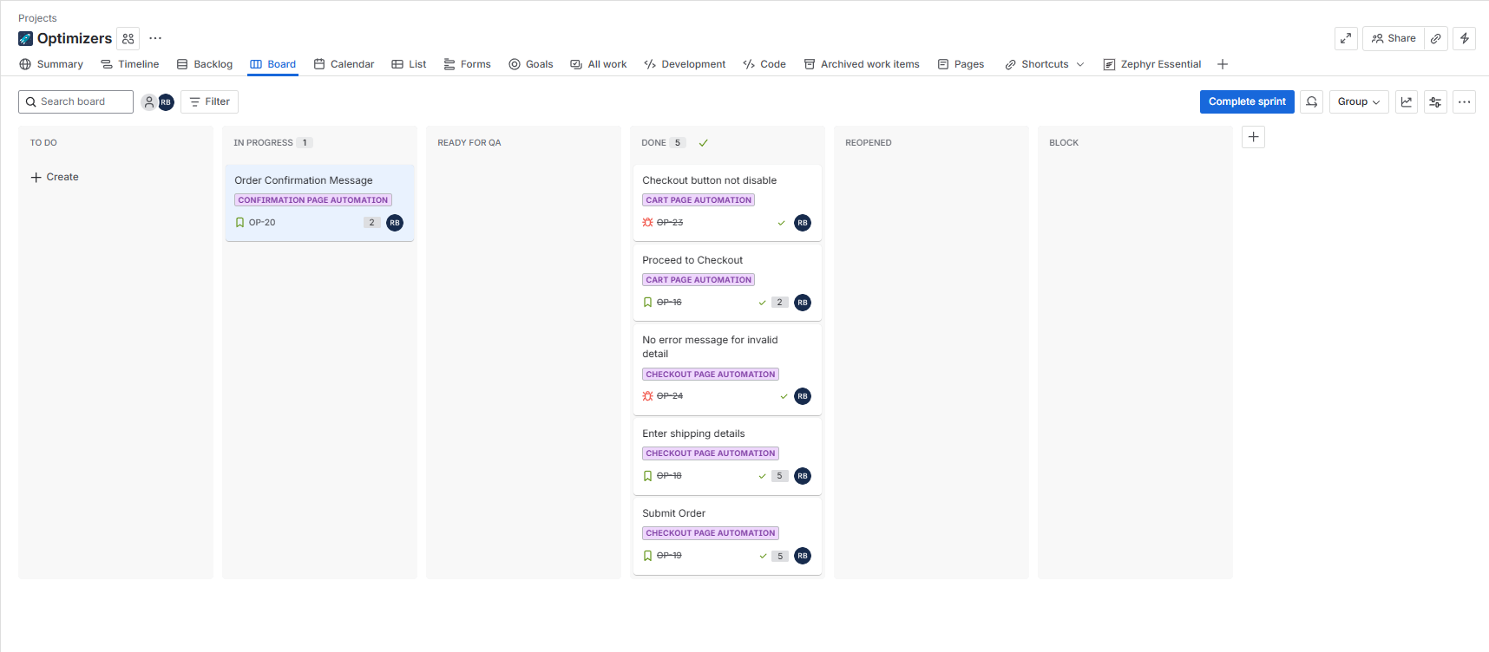
Link for Jira
Jira
Board
Board: Visual representation of tasks organized by status, enabling easy tracking of team work.

Slide 11
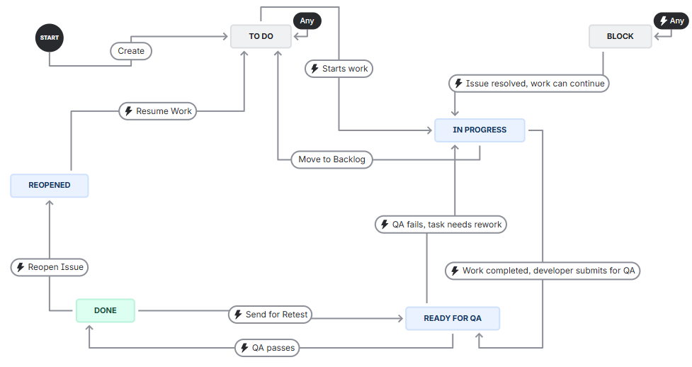
Link for Jira
Jira Board
Workflow – Shows the path each story, task, or bug follows
(e.g., To Do → In Progress → Review → Done).

Slide 12
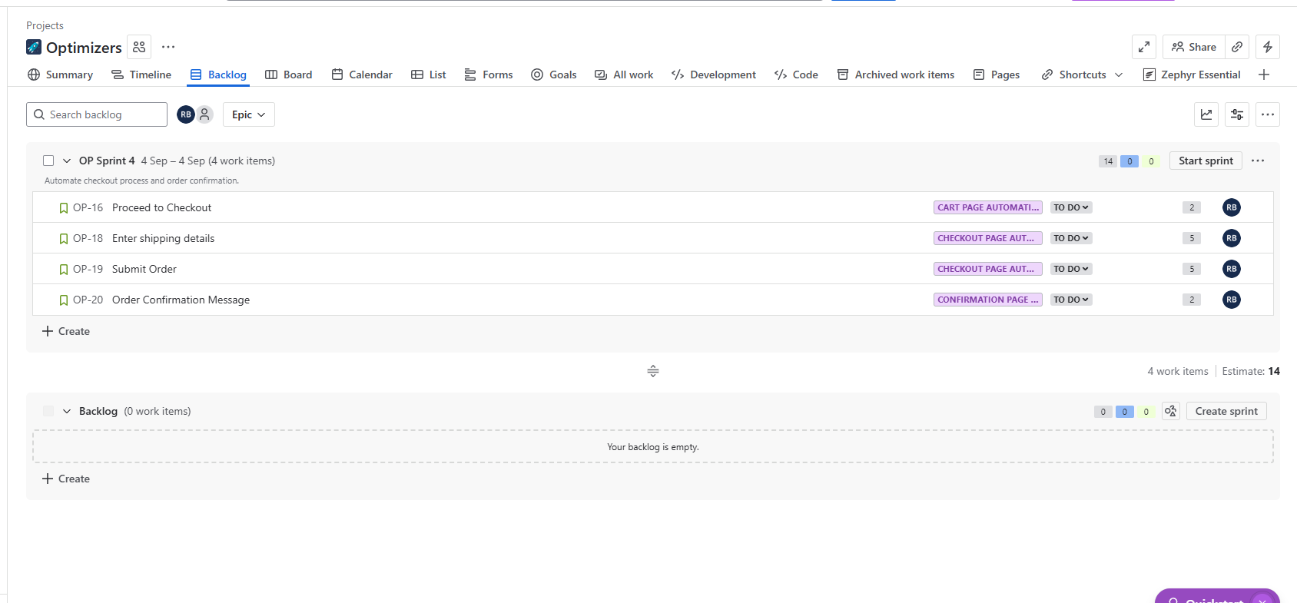
Link for Jira
Jira Board
Backlog – List of all pending user stories and tasks that are yet to be planned into sprints.

Slide 13
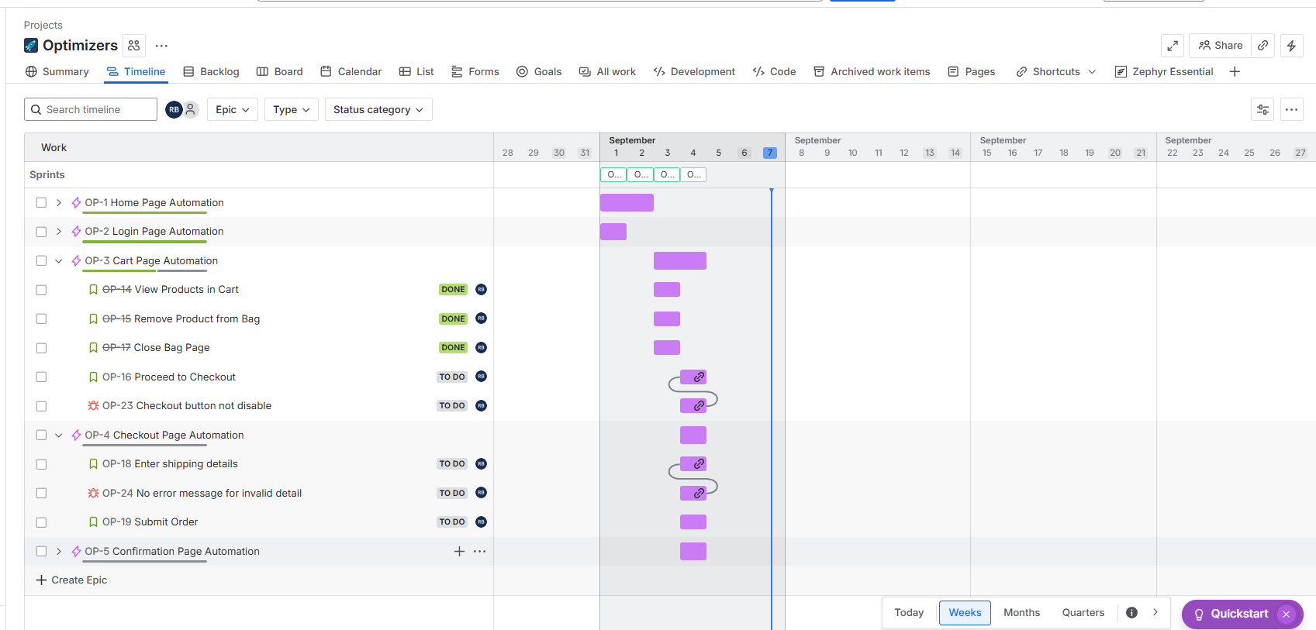
Link for Jira
Agile Board
Timeline – Displays epics and stories along a timeline, helping track progress and deadlines clearly.

Slide 14

Zephyr
Board

Slide 15
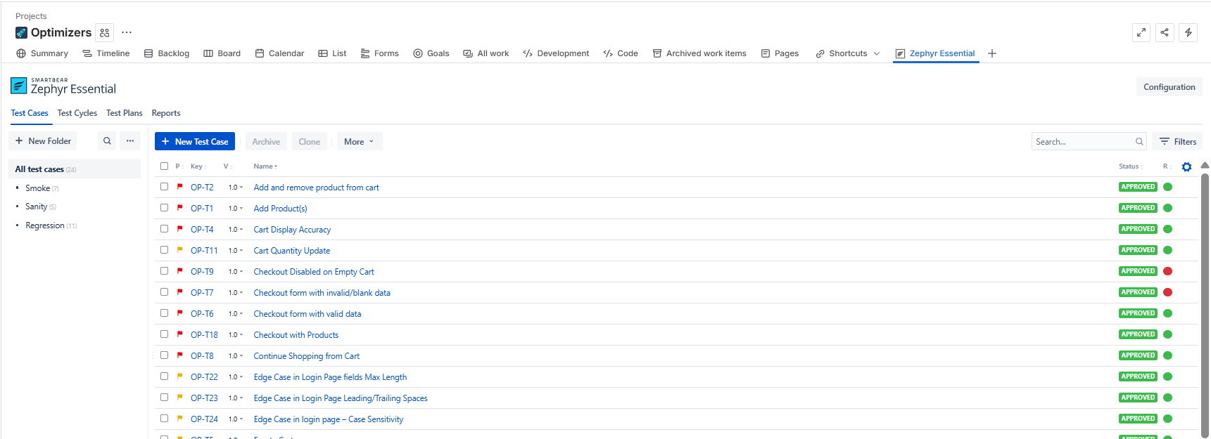
Zephyr
Board
Test cases: Repository showing all created test cases.

Slide 16
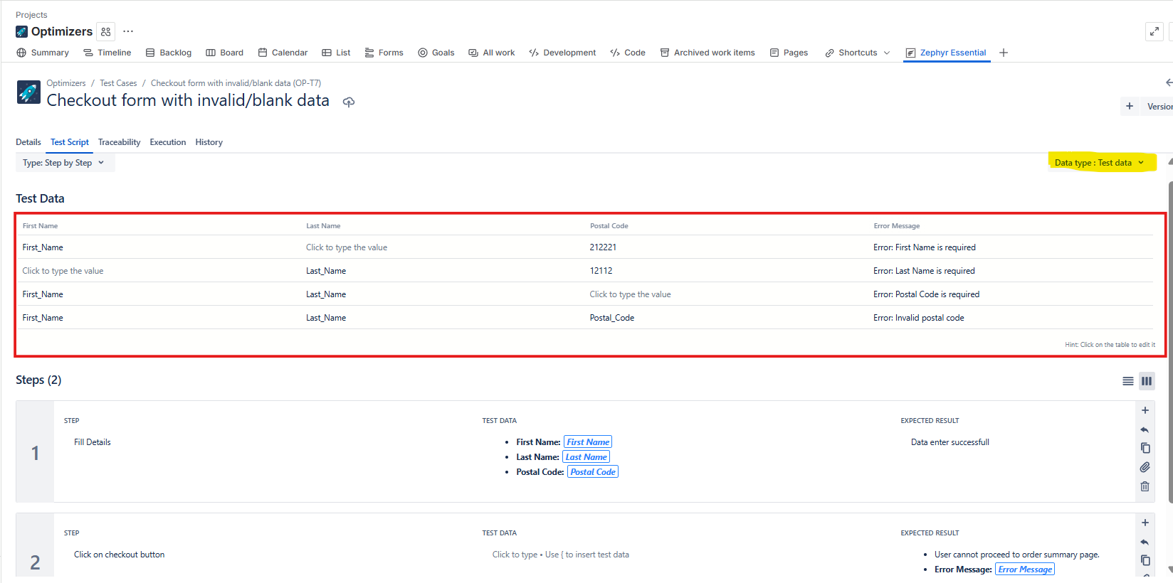
Zephyr
Board
Each test case is written with clear steps. Test Data field is used to provide multiple inputs. Same test case can run with different sets of data (data-driven).

Slide 17
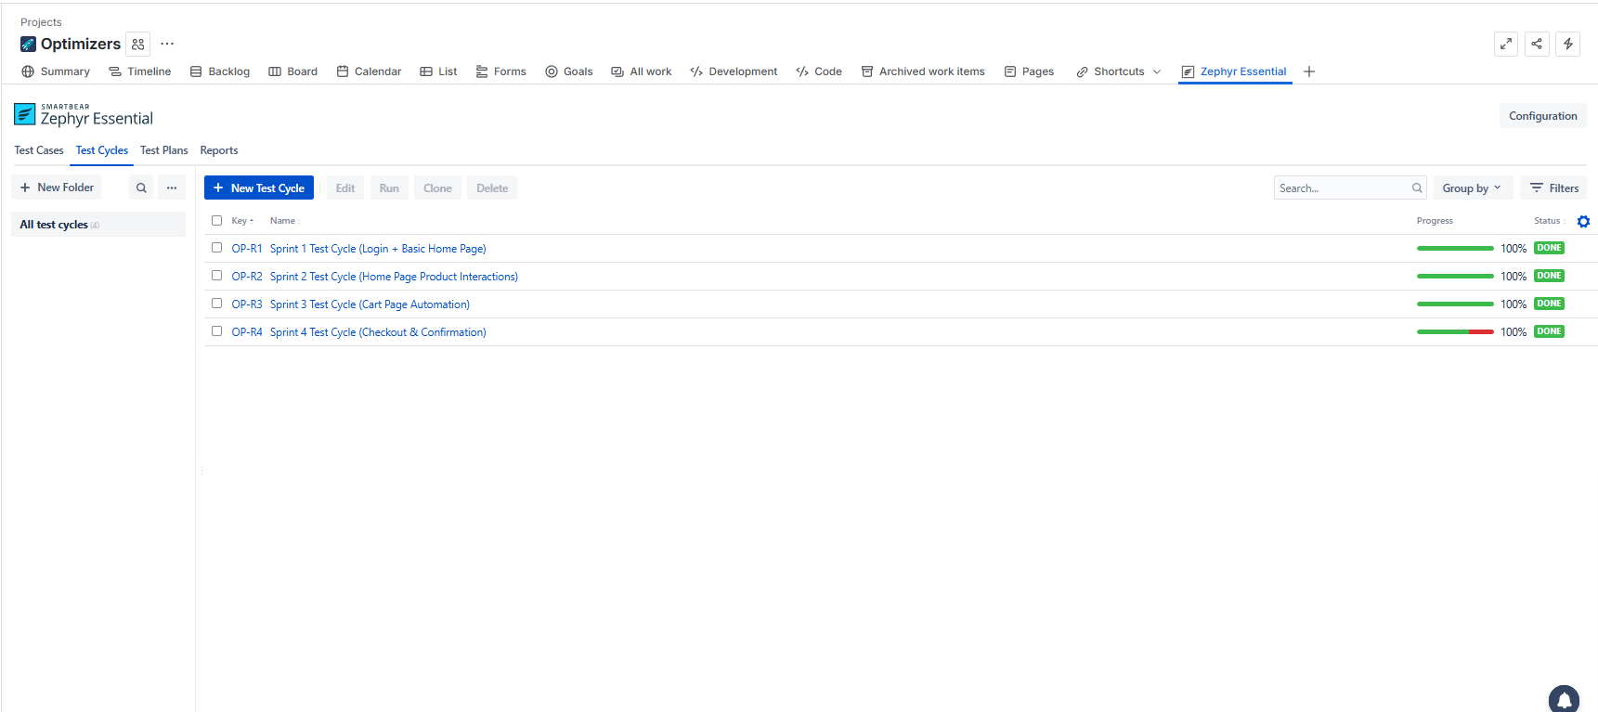
Zephyr
Board
Test Cycles – Collection of test cases grouped per sprint.

Slide 18
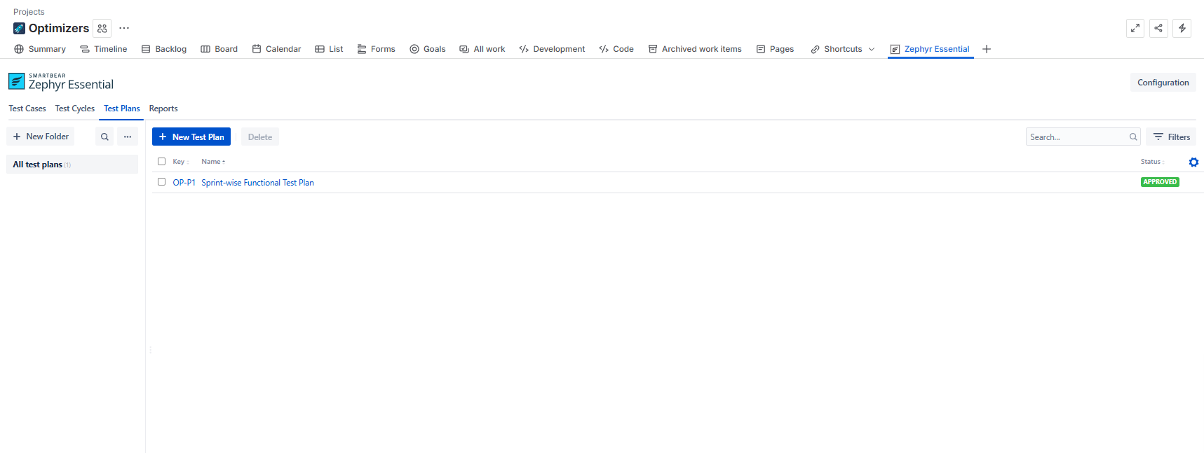
Zephyr
Board
Test Plan – High-level plan combining multiple test cycles.

Slide 19
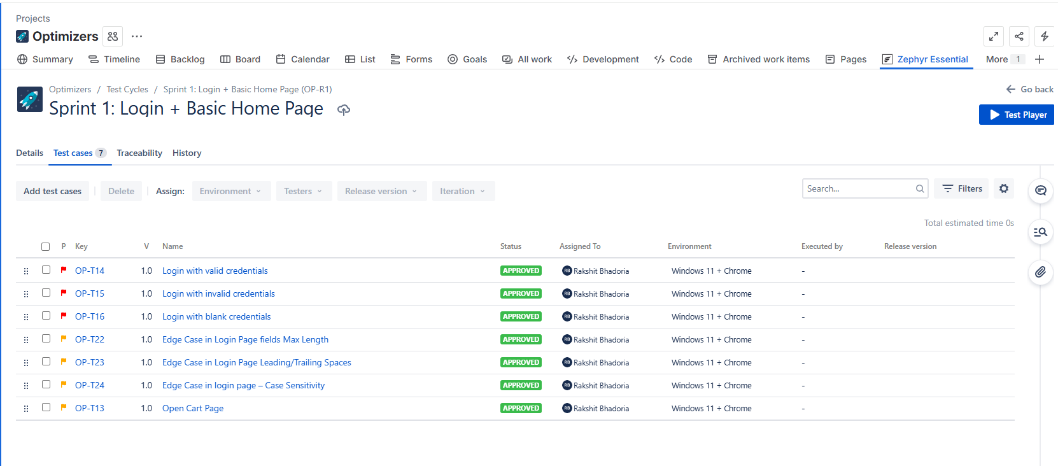
Zephyr
Board
Test Cycle View – Shows one cycle with all test cases inside the test cycle

Slide 20
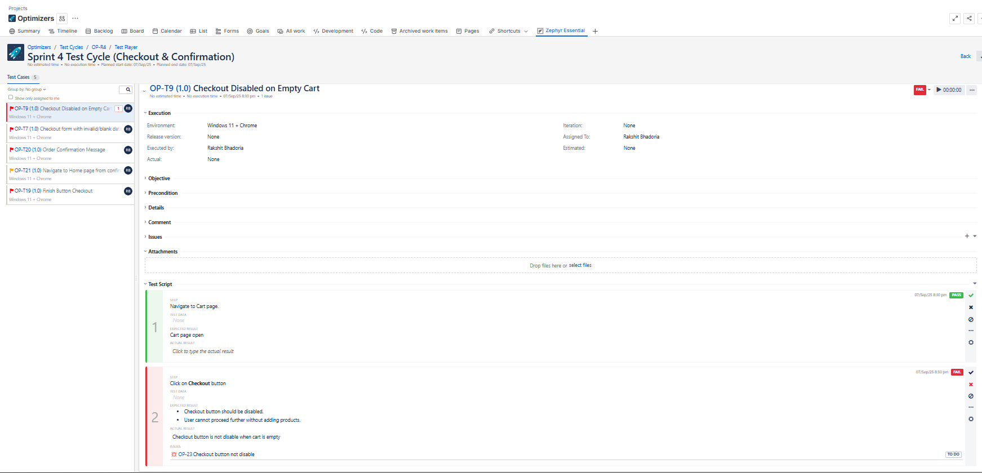
Zephyr
Board
Failed Test Handling – When a test fails, we can create an issue/bug at that failed step.

Slide 21
Zephyr
Board
Issue Linking – Reported issues are linked to the respective user story they block.

Slide 22

Test
Report

Slide 23
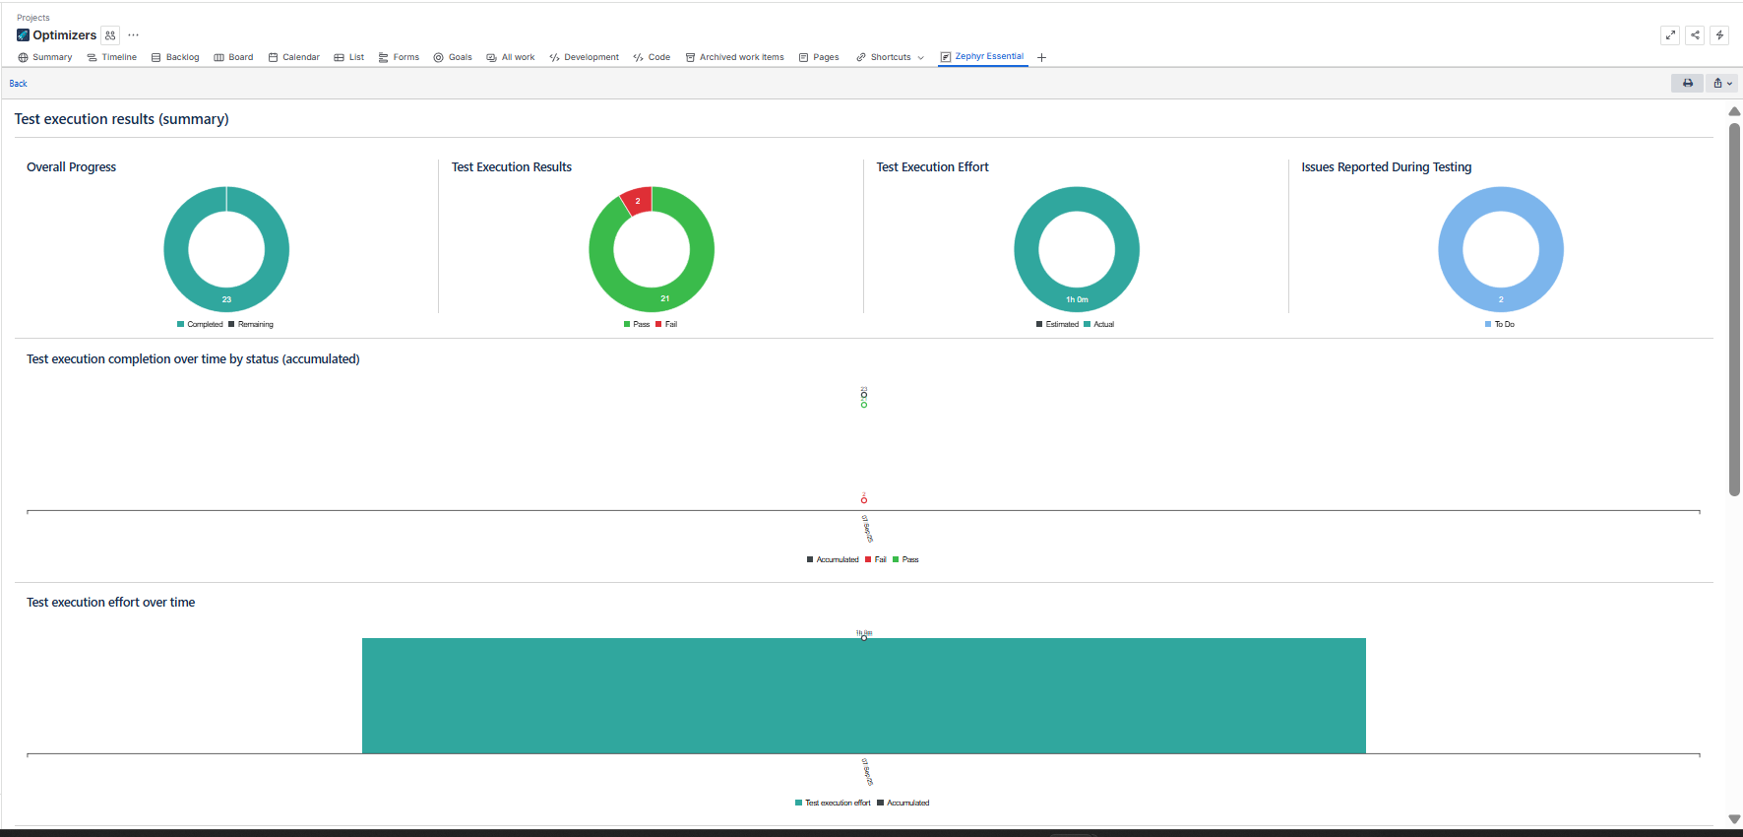
Test
Report
Zephyr Test Report – Provides execution status of test cases (Pass/Fail/Blocked), linked with user stories for better traceability.

Slide 24
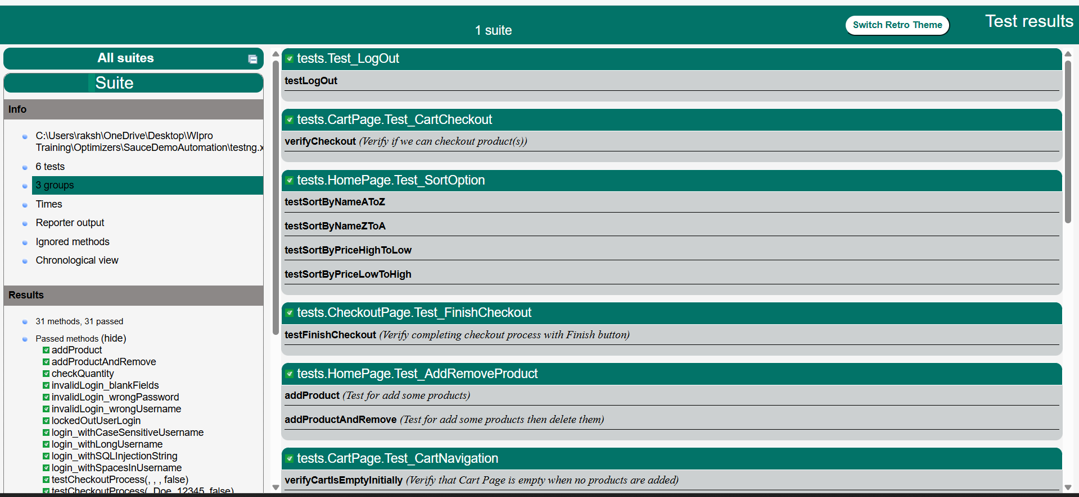
Test
Report
Test Report – Provides execution status of test cases (Pass/Fail/Blocked), linked with

Slide 25

Jenkins

Slide 26
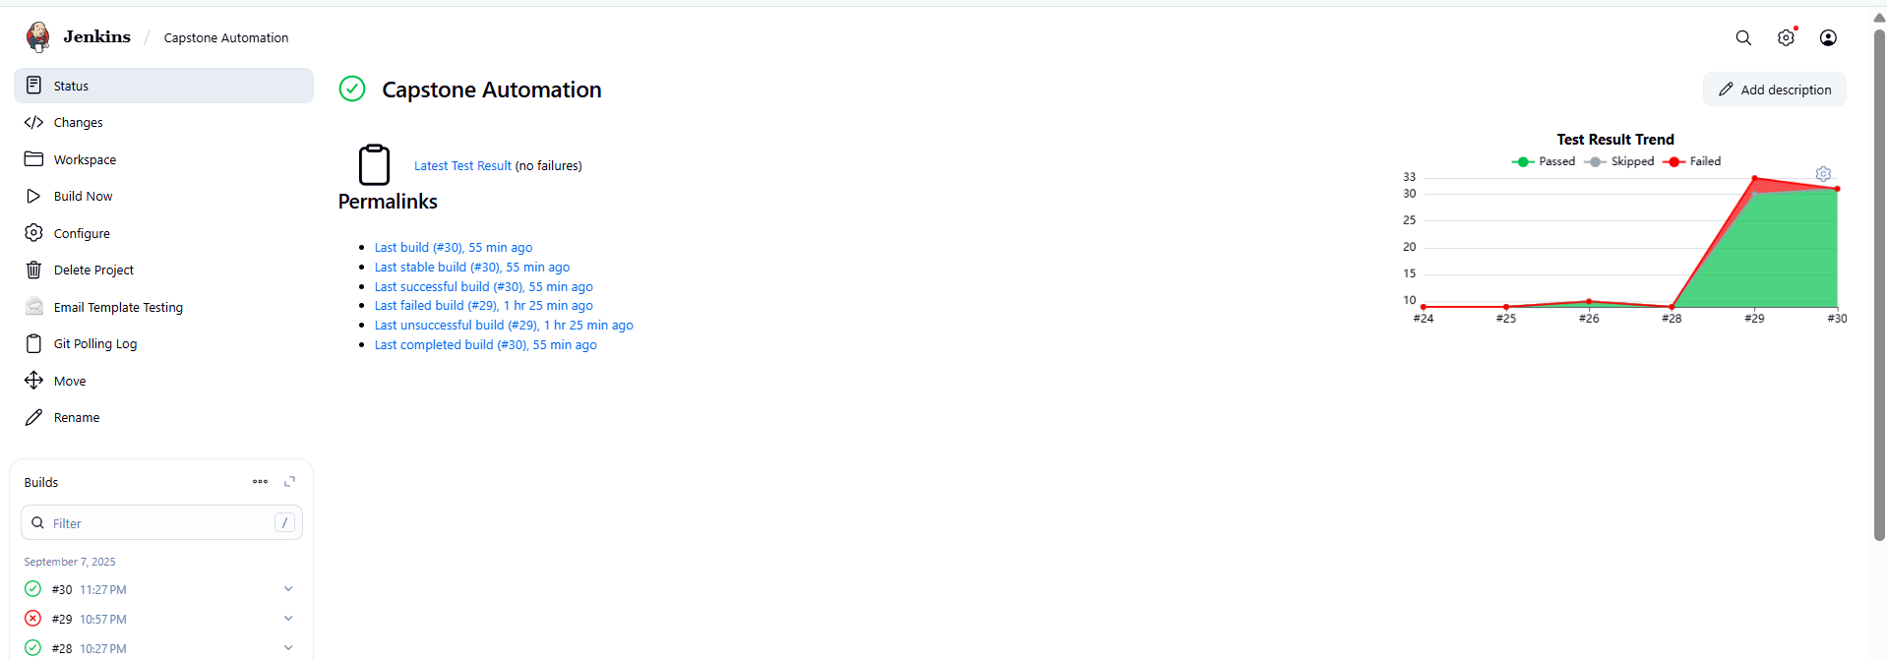
Jenkins
Job View (Capstone Automation) – Displays build history with a graph showing pass/fail trends for each build.

Slide 27
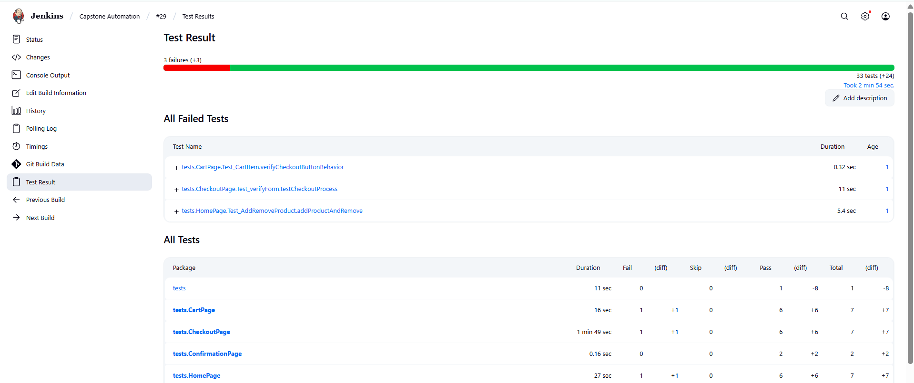
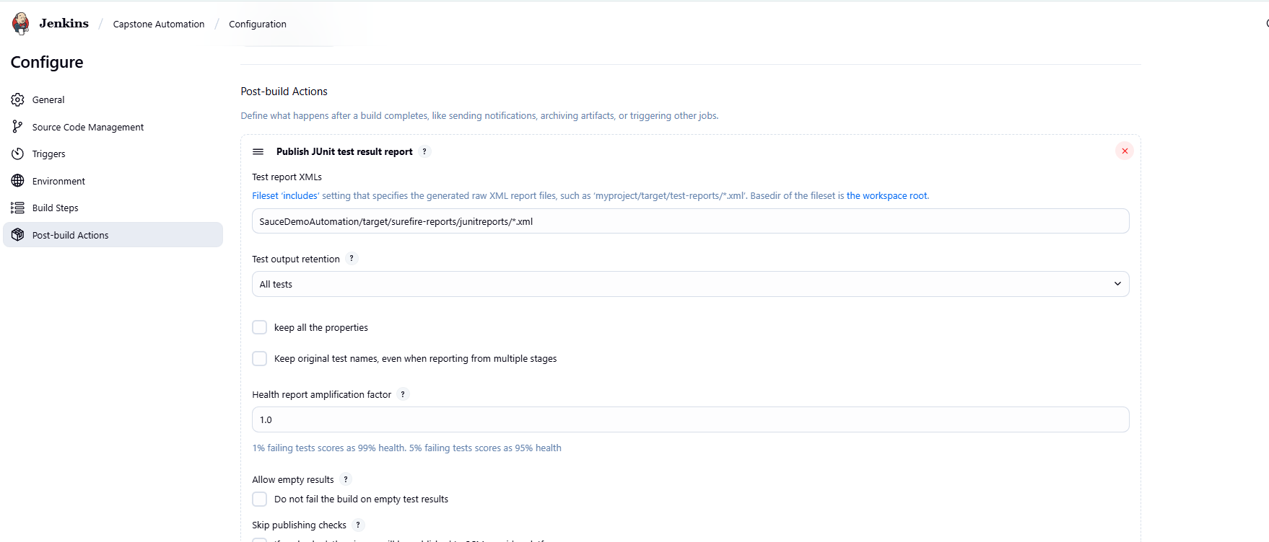
Jenkins
Post-Build Action (JUnit Reports) – Publishes detailed test results after every build for easy review.

Slide 28
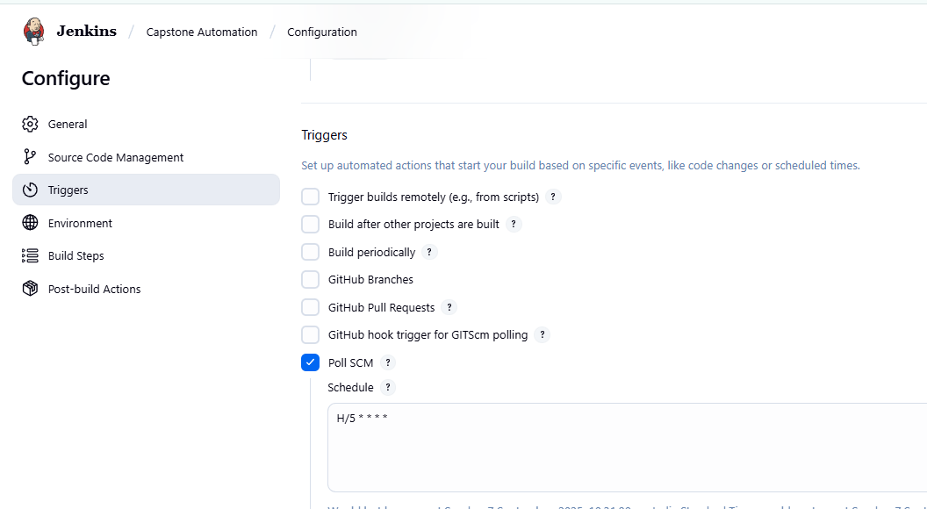
Jenkins
GitHub Trigger – Automatically starts a build whenever a new commit is pushed to the repository.
Poll SCM (Source Code Management)- Poll SCM is a Jenkins option that periodically checks for changes in the repo instead of building on a fixed schedule. If changes exist, it triggers the pipeline automatically.

Slide 29
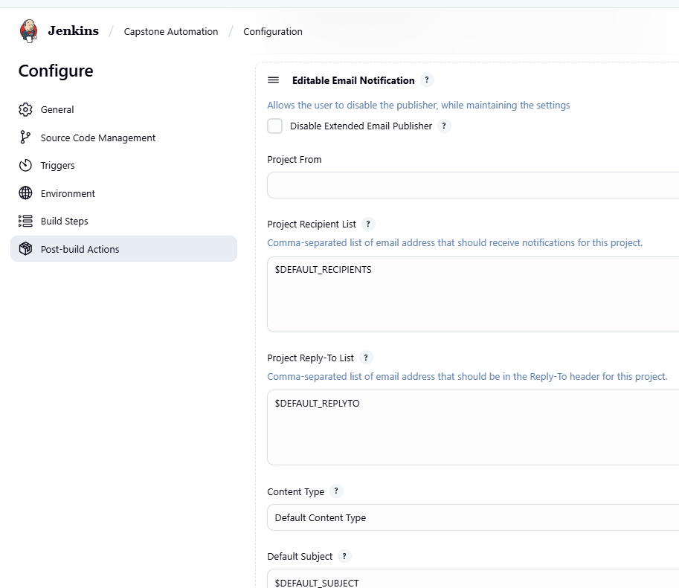
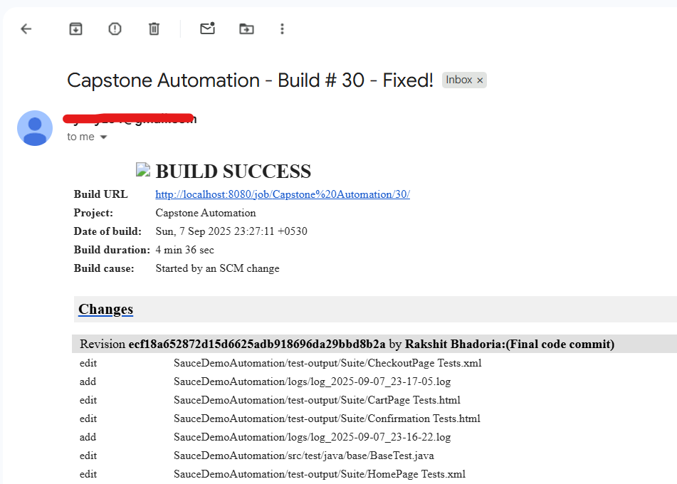
Jenkins
Email Notification – Sends an email after each build with logs attached, indicating success or failure.

Slide 30
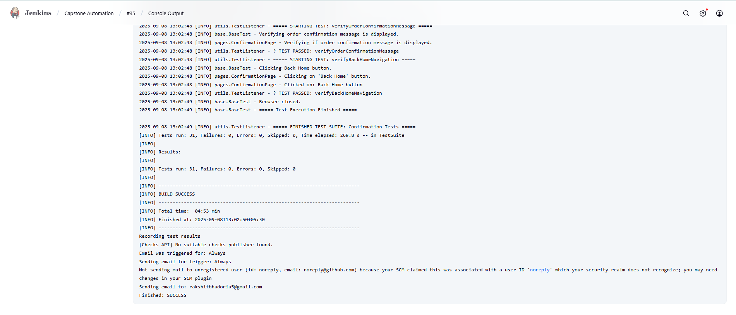
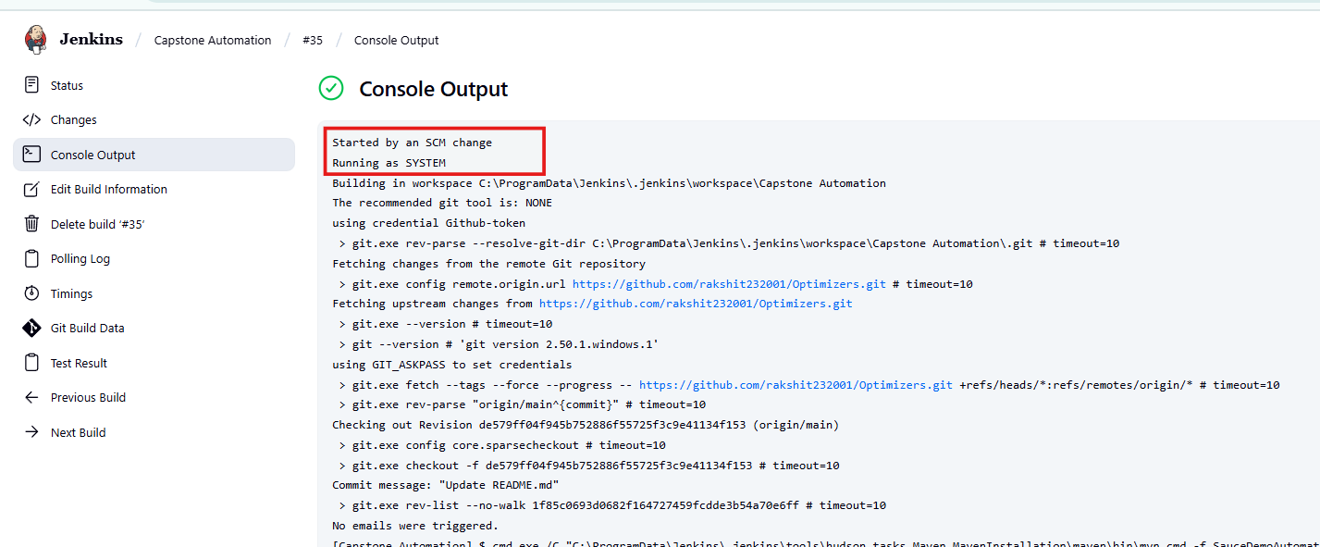
Jenkins
Console Output of a build automatically trigger

Slide 31

Eclipse
&
GitHub

Slide 32
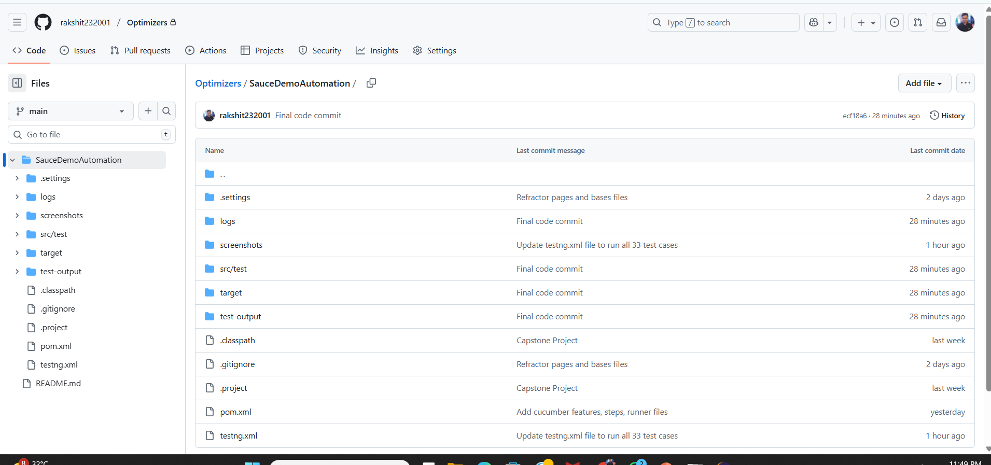
Eclipse & GitHub
GitHub Repository – Shows all project files and folders stored online for version control and collaboration.

Slide 33
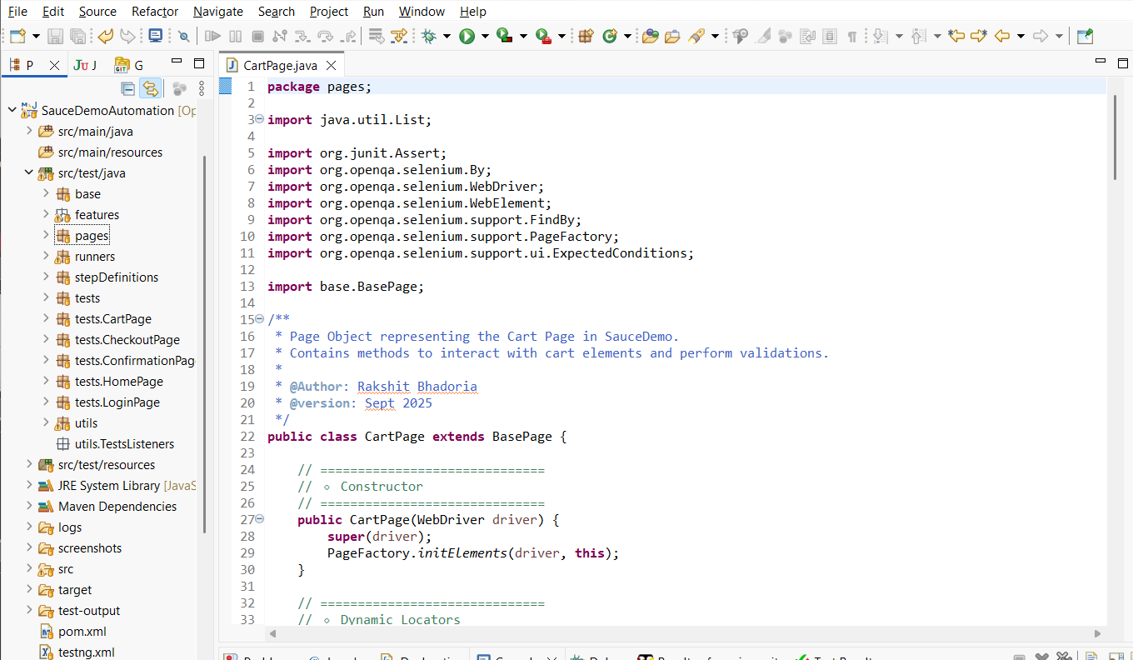
Eclipse & GitHub
Eclipse IDE – Displays the local folder structure and files in the workspace for easy development and debugging.

Slide 34

End

Slide 35
The End
Thank You!

